Slide 1

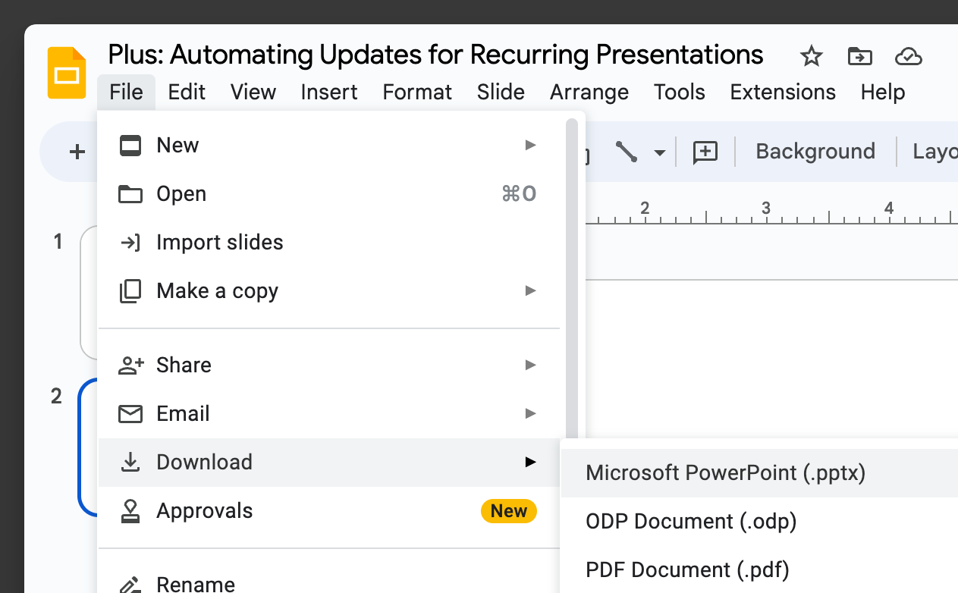

README
How to use this presentation
Make a copy of this presentation in Google Slides.
⚠️This document will be deleted in 30 days.
Customize and use it however you’d like
Once you make a copy, you will have full edit control, just like any other Google Slides presentation.
You can also download the presentation as a PowerPoint and PDF, and more.

Slide 2

Toward Efficient Learning: Model-Agnostic Meta-Learning for Fast Adaptation of Deep Networks
May 13, 2024

Slide 3
Agenda
Introduction to Model-Agnostic Meta-Learning
Real-World Application Scenario
Human Learning vs. Machine Learning
Core Concepts of MAML
The MAML Algorithm Illustrated
Learning and Meta-Learning Phases
Experimental Setup and Data Sets
Conclusion and Future Applications

Slide 4

Introduction to Model-Agnostic Meta-Learning
Plus tip:
Overview
Consider incorporating visuals or diagrams to illustrate the concept of MAML for better understanding.
Model-Agnostic Meta-Learning (MAML) enables rapid adaptation to new tasks, mimicking human learning. It focuses on identifying easily adaptable model parameters and minimizing the data needed for task adaptation.

Slide 5

Real-World Application Scenario
Application
MAML is applied in image classification, where a model is trained to recognize categories like cat, duck, lion, and apple.
In a scenario requiring new classes 'orange' and 'bike', MAML enables fast adaptation with minimal data.
Traditional methods would necessitate labeling many new images for 'orange' and 'bike', making the process inefficient.
MAML aims to tackle the challenge of rapid adaptation to new classes by utilizing existing data more efficiently.

Slide 6

Human Learning vs. Machine Learning
Plus tip:
Learning Comparison
Highlight the contrast between human learning and machine learning in terms of efficiency and adaptability to new tasks. Use examples to illustrate the difference.
Human Learning
Humans can recognize objects from just a few examples, demonstrating the efficiency of human learning.
Learning new skills after a few minutes of experience is a common human ability.
Human intelligence allows for quick adaptation to new tasks, requiring minimal data.
Machine Learning
Traditional machine learning models require significantly more data points to learn new tasks.
Efficiency is lower compared to human learning, especially when tasks require adaptability to new data scenarios.
Machine learning algorithms typically need extensive data sets for training, making them less efficient in scenarios with limited data.

Slide 7

Core Concepts of MAML
MAML
Parameter Adaptation and Minimizing Data Needs
MAML focuses on identifying parameters that are easy to adapt for new tasks, aiming to minimize the need for extensive retraining with new data.
Utilizing Minimal Gradient Updates
The algorithm emphasizes the use of a small number of gradient updates, or even a single update, to tailor the model to new tasks efficiently.
Meta-Learning for Rapid Task Adaptation
A key aspect of MAML is the concept of 'meta-learning,' where the model learns how to learn new tasks quickly based on past experience.

Slide 8

The MAML Algorithm Illustrated
Algorithm
Initial Training
Meta-Learning
Gradient Calculation
Parameter Update
Initial learning phase where the model is trained on multiple tasks with limited data for each task.
Meta-learning phase to capture the essential features of the tasks and learn how to adapt quickly to new data.
Gradient calculation for each task to determine the direction of parameter update for task optimization.
Parameter update step guided by the calculated gradients to improve task performance and achieve adaptation.
Trained model on initial tasks
Limited data utilization
Basic task understanding
Parameter identification for fast adaptation
Core task feature extraction
Meta-optimization for quick task learning
Gradient computation for each task
Directional parameter update determination
Optimal update direction for task performance
Parameter update guided by task gradients
Improved task performance
Enhanced adaptation capability

Slide 9

Learning and Meta-Learning Phases
Plus tip:
MAML
To effectively convey the concept of meta-learning to your audience, consider using relatable examples or visuals that illustrate the process of adapting to new tasks quickly.
MAML involves two primary phases: the initial learning phase and the meta-learning phase.
During the initial learning phase, the model is trained on a specific task with a dataset.
The meta-learning phase utilizes a support or validation dataset to further adapt the model to new tasks, enhancing its ability for rapid task adaptation.
This two-phase approach mirrors the way humans learn, enabling machines to quickly grasp new concepts with minimal data.

Slide 10

Experimental Setup and Data Sets
Experiment
Omniglot, Mini ImageNet
1623 chars, 50 alphabets; 64 classes
12 classes
24 classes
Data Sets
Training Classes
Validation Classes
Testing Classes

Slide 11
Plus tip:
Conclusion
Customize this slide by adding specific examples of MAML applications in your industry. Highlight how MAML's capability to quickly learn new tasks can address current challenges or improve operational efficiency.
MAML facilitates rapid learning of new tasks.
MAML enables rapid adaptation to new tasks, minimizing the need for extensive data. This efficiency opens doors to various applications in sectors like healthcare, finance, and robotics, enhancing productivity and innovation.

Slide 12
Thank you.

